Slide 1

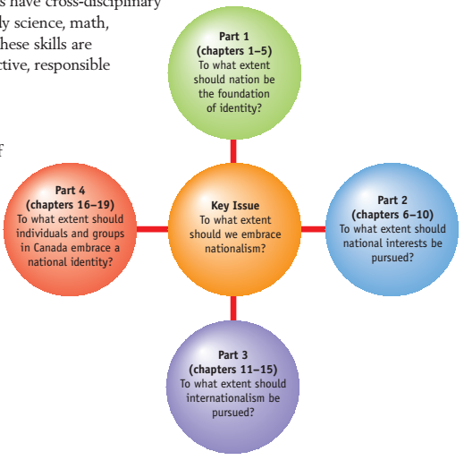
Social Studies 20-1

Slide 2
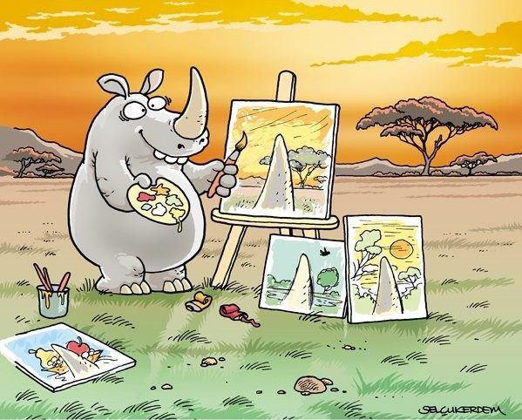
Key Terms
Point of View - an individual’s opinion about a matter, based on his or her personal experience.
Perspective - a people’s world view, one that has developed from its collective experience

Slide 3
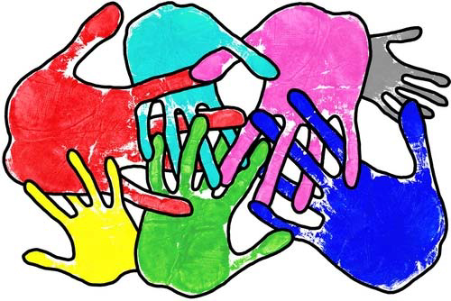
Pluralism - Canada is a pluralistic society. This means a society which has a diversity of languages, beliefs, traditions, values, religions and other aspects of culture.
Aboriginal — A term encompassing First Nations, Metis, and Inuit peoples.

Slide 4
Identity - In social studies, the term identity refers to a condition in which people feel a sense of similarity or sameness with others of their religion, race, ethnicity, or nationality.
It is a feeling that can be solidified through symbols thought to represent these similarities, such as the Maple Leaf in Canada or the Star of David for Jewish people.
It can also be developed through a shared history, language, or effort to ensure traditions associated with a group are passed through generations.

Slide 5
Understandings of Nation and Nationalism
Chapter Issue:
To what extent do understandings of nation and
nationalism vary?

Slide 6
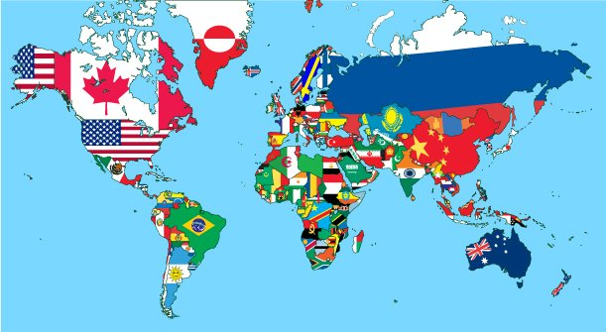
Section 1 - Understandings of Nation
Nation - The term nation refers to a group of people living in or related to a specific geographic region. A nation often has a sovereign government and possesses distinct laws, cultures, and traditions.
A nation-state is a sovereign country in which the majority of its citizens often share common cultures, traditions, and languages.
A nation-state has its own system of government, currency, and official language(s).

Slide 7
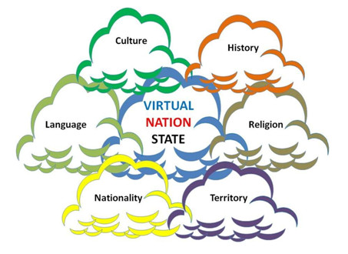
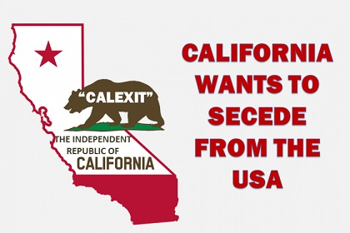
A nation can refer to a group of people with similar cultures, traditions, and languages who inhabit a specific area but do not have the ability to govern themselves and who do not possess characteristics of a nation-state (e.g., currency).
In some instances, nation-states have been created when the leaders of various nations decide they would like to unite and form an independent country.

Slide 8
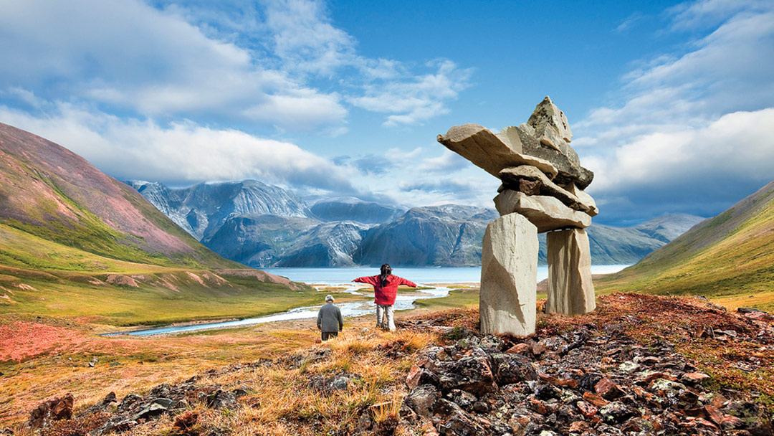
Section 2 - Understanding Nationalism
There are many different types of nationalism because people in a nation feel different connections to each other and their environment.
A person's relationship to the land can create feelings of nationalism. This connection to the environment can be generations old and can cause people to feel a sense of sameness with those around them who share a history with that region.

Slide 9
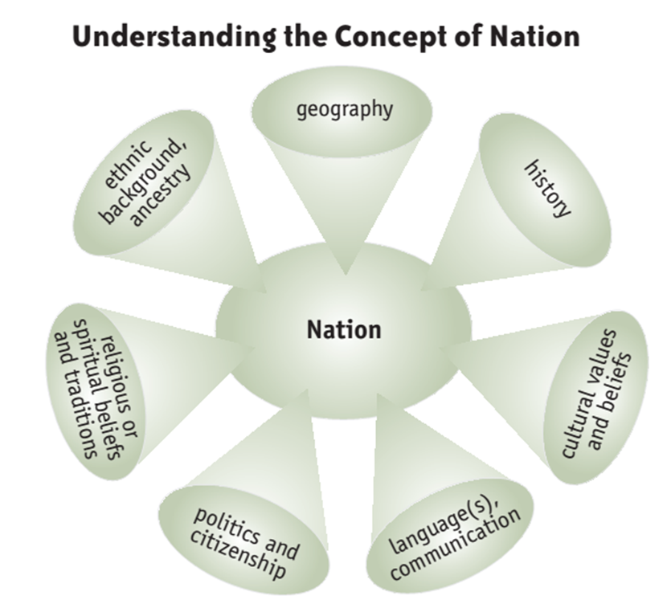
A collective sense of nationalism is when people believe themselves to be part of a group unique to other groups.
Shared experiences, language, beliefs, goals, or culture can make people feel like part of a group, thus encouraging a feeling of nationhood.

Slide 10
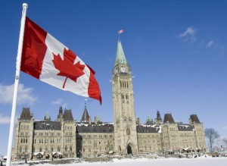

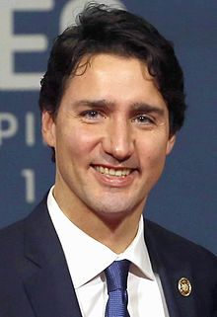
Civic nationalism binds people together through a shared belief in the same laws, values, and political traditions. It is capable of uniting people who do not share the same race, ethnicity, culture, or language.

Slide 11
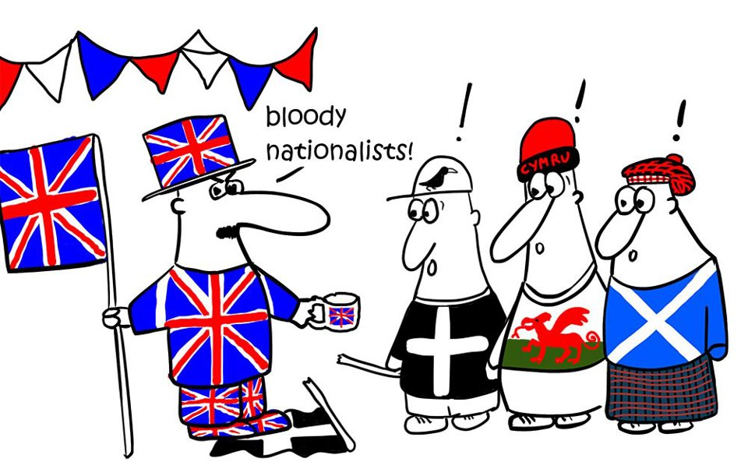
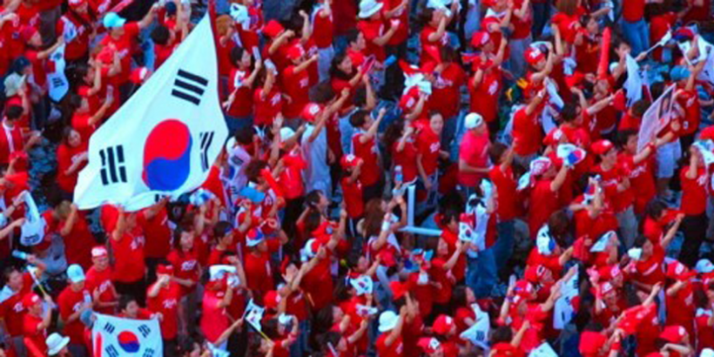
Ethnic nationalism develops when people share a common ethnic history, usually with many generations of ancestors sharing that ethnicity.
Cultural nationalism develops when a group of people share a common culture with similar traditions, artistic expressions, foods, and attire. Often, people who share a cultural nationalism share the same ethnicity, but this is not always true.

Slide 12


Linguistic nationalism exists among people who share a similar language and a desire to protect it, even if they are of different ethnicities or cultures.
Political nationalism exists when people share a desire to govern themselves independently and without influence from other countries. Although people in such a group may not actually have their own country, they share a sense of nationalism out of the desire to achieve this autonomy.

Slide 13
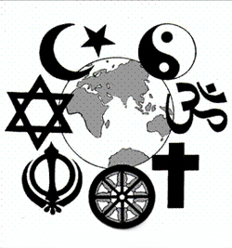
Religious nationalism exists when people share the same or similar religious beliefs, even if they live in different countries and speak different languages.
Spiritual nationalism is closely related to both religion and a person's relationship to the land. Religious beliefs may spur feelings of spirituality about a geographic location, which creates a sense of nationhood among people. Sometimes, people will make pilgrimages to these places, which also strengthens their feelings of nationalism and connectedness with the area.

Slide 14
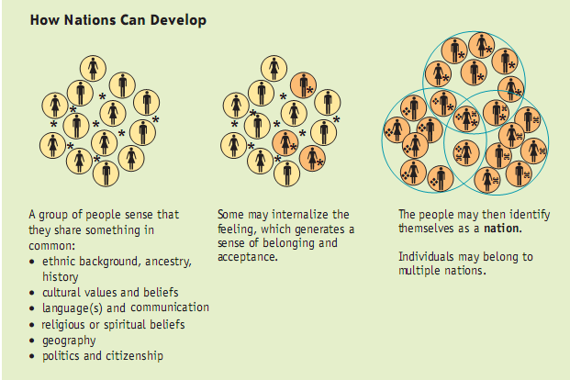
Patriotic nationalism exists when people have a shared feeling of love for their country. These people may speak different languages or practice different religions, but their common sense of love for their country creates a sense of nationalism among them.

Slide 15
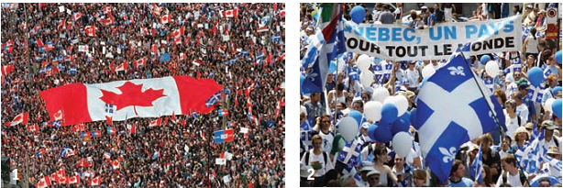
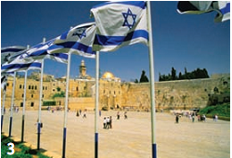

Geography, language, spirituality and religion, ethnicity, culture, and citizenship can all inspire a sense of nationalism among members of a nation.

